Slide 1
第3章 选择

Slide 2
boolean数据类型
Boolean值（布尔值）:
  true(真)
  false(假)
  例如：boolean b = (1 > 2);

Slide 3
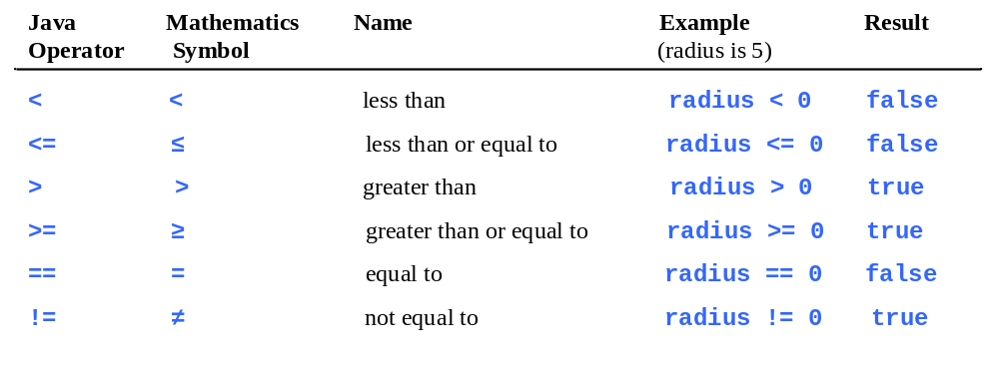
关系操作符

Slide 4
示例: 简单整数加法器
该程序让一年级学生练习加法。程序随机产生两个一位数，number1和number2，然后显示 “What is 7 + 9?” ，当学生在对话框中输入答案后，程序显示答案是tren还是false。
重要提醒: 如果你无法运行按钮，请看 www.cs.armstrong.edu/liang/javaslidenote.doc.
动画
AdditionQuiz
Run

Slide 5
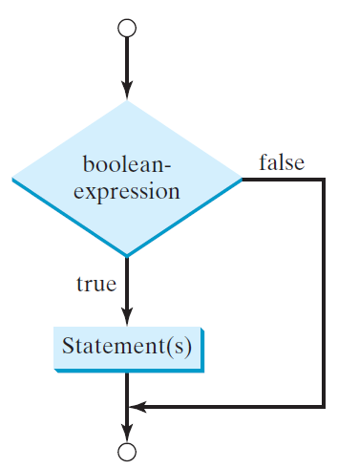
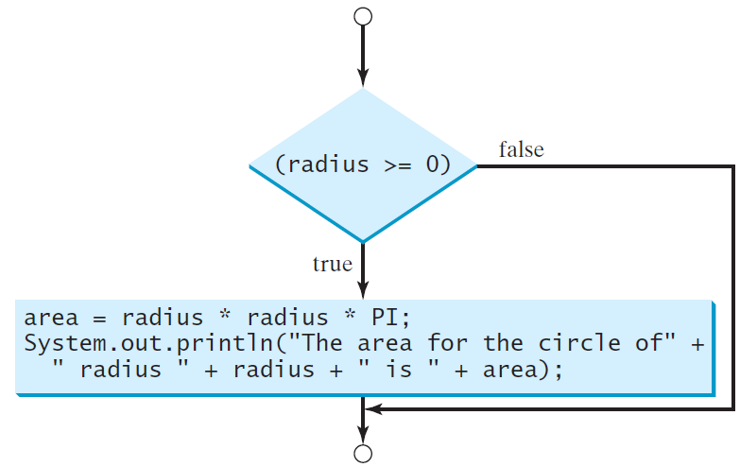
if语句
单分支if语法：
if (boolean-expression){
statement(s);
}
if (radius >= 0) {
area = radius * radius * PI;
System.out.println("The area” + " for the circle of radius "
+ radius + " is " + area);
}

Slide 6
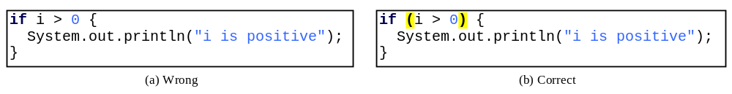
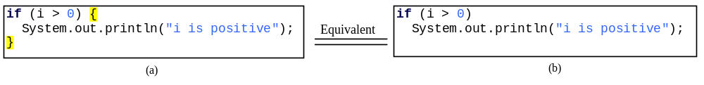
注意
布尔表达式应该用括号括住，即if后的圆括号( )不能省略
如果花括号内只有一条语句，则可以省略花括号

Slide 7
简单if示例程序
程序提示用户输入一个整数，如果该数是5的倍数，打印HiFive，如果是2的倍数，打印HiEven。
Animation
SimpleIfDemo
Run

Slide 8
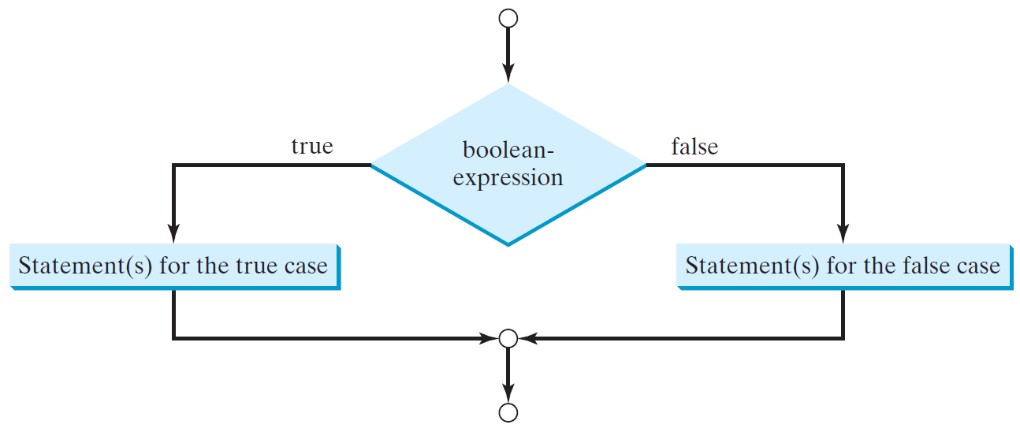
双分支if-else语句
双分支if-else语句语法：
if (boolean-expression) {
statement(s)-for-the-true-case;}
else {
statement(s)-for-the-false-case;｝

Slide 9
if-else示例
示例：
if (radius >= 0) {
area = radius * radius * 3.14159;
System.out.println("The area for the "
+ "circle of radius " + radius +
" is " + area);
}
else {
System.out.println("Negative input");
}

Slide 10
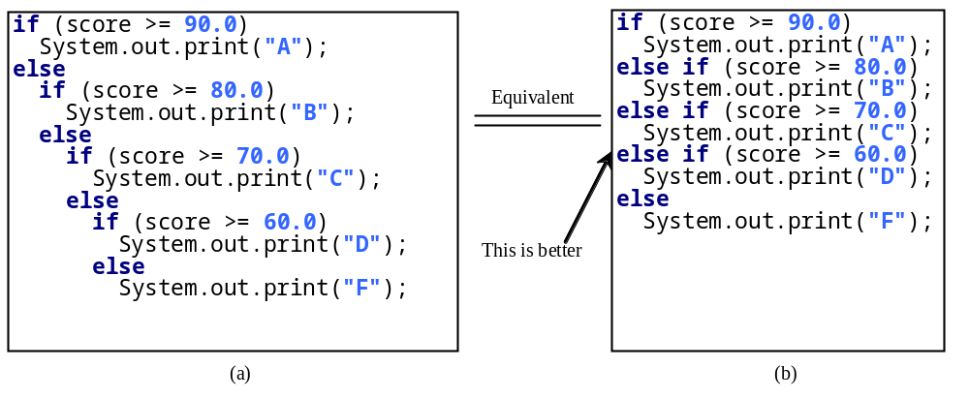
嵌套的if语句
(a)嵌套的if语句 (可以多层嵌套，一般情况下内层嵌套书写缩进)
(b)这种格式风格，称为多分支if-else语句，可以避免深度缩进，并使程序易于阅读。

Slide 11
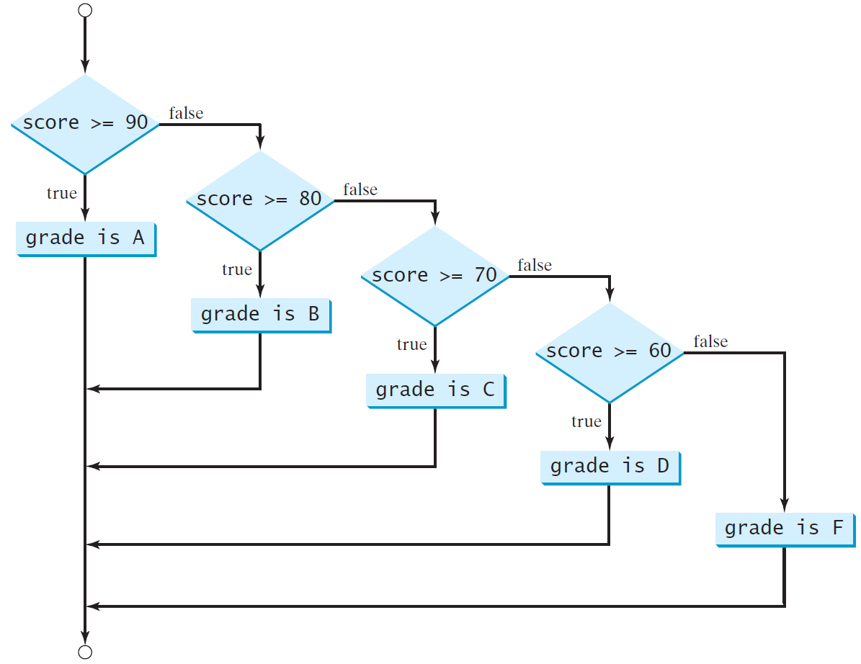
多分支的if-else语句

Slide 12
if-else 语句跟踪
动画
假设分数是 70.0
该条件为 false
if (score >= 90.0)
System.out.print("A");
else if (score >= 80.0)
System.out.print("B");
else if (score >= 70.0)
System.out.print("C");
else if (score >= 60.0)
System.out.print("D");
else
System.out.print("F");

Slide 13
if-else 语句跟踪
动画
假设分数是 70.0
该条件为 false
if (score >= 90.0)
System.out.print("A");
else if (score >= 80.0)
System.out.print("B");
else if (score >= 70.0)
System.out.print("C");
else if (score >= 60.0)
System.out.print("D");
else
System.out.print("F");

Slide 14
if-else 语句跟踪
动画
假设分数是 70.0
该条件为 true
if (score >= 90.0)
System.out.print("A");
else if (score >= 80.0)
System.out.print("B");
else if (score >= 70.0)
System.out.print("C");
else if (score >= 60.0)
System.out.print("D");
else
System.out.print("F");

Slide 15
if-else 语句跟踪
动画
假设分数是 70.0
成绩为 C
if (score >= 90.0)
System.out.print("A");
else if (score >= 80.0)
System.out.print("B");
else if (score >= 70.0)
System.out.print("C");
else if (score >= 60.0)
System.out.print("D");
else
System.out.print("F");

Slide 16
if-else 语句跟踪
动画
假设分数是 70.0
结束if语句
if (score >= 90.0)
System.out.print("A");
else if (score >= 80.0)
System.out.print("B");
else if (score >= 70.0)
System.out.print("C");
else if (score >= 60.0)
System.out.print("D");
else
System.out.print("F");

Slide 17
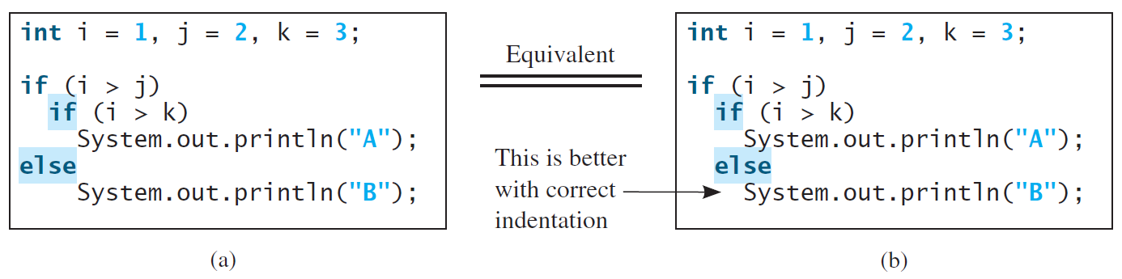
注意
在一个块中else语句总是与距离它最近的那个if语句配对。
(a)、(b)代码段都将不打印任何东西
注意正确的代码缩进（ indentation ）！！！

Slide 18
注意
为了使else与第一个if配对，必须添加花括号:
      int i = 1, j = 2, k = 3;
      if (i > j) {
      if (i > k)
      System.out.println("A");
      }
      else
      System.out.println("B");
      这条语句会打印出 B.
建议：不轻易省略花括号{ }

Slide 19
常见错误
在if表达式后出现错误的“;”
    if (radius >= 0);
    {
    area = radius*radius*PI;
    System.out.println(
    "The area for the circle of radius " +
    radius + " is " + area);
    }
Logic Error
  等价于：
  if (radius >= 0) { }; //花括号中为空语句
  {
  // 省略代码块
  }

Slide 20
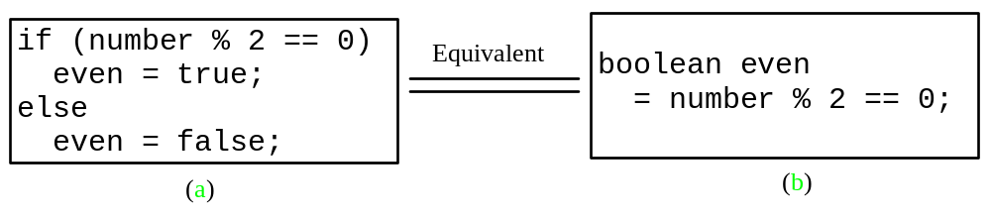
建议

Slide 21
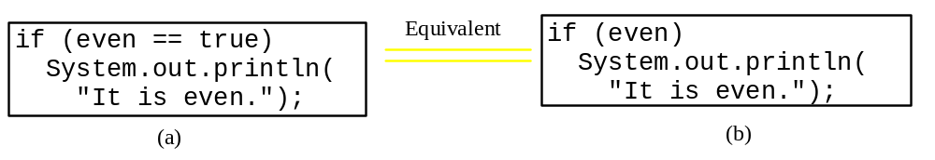
注意

Slide 22

示例：简单整数减法器
该程序让一年级学生练习减法。程序随机产生两个一位数 number1和number2，且满足 with number1 >= number2 。程序向学生显示问题，如 “What is 9 – 2?” 。学生输入答案后程序显示该答案是否正确。
SubtractionQuiz

Slide 23
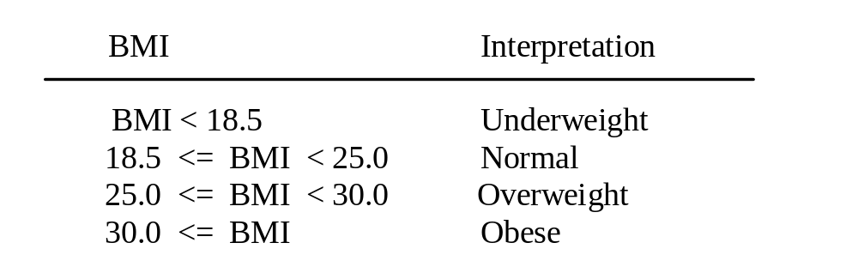
示例：计算身体质量指数
身体质量指数 (BMI) 是关于体重指标的健康测量，可以通过以千克为单位的体重除以以米为单位的身高的平方得到。针对20岁及以上年龄的人群，他们的BMI值说明如下:
ComputeAndInterpretBMI

Slide 24
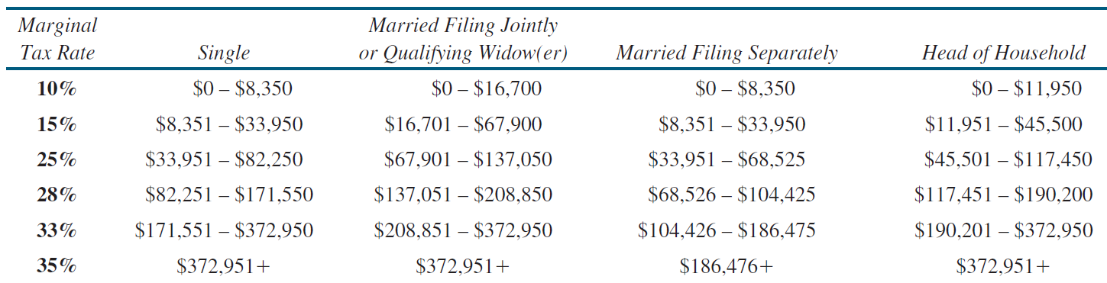
示例学习：计算税率
美国国家联邦个人收入所得税是基于纳税人登记的 身份和可征税收入计算的。其身份分为四种：单身纳税人(single)，已婚共同纳税人(Married Filing Jointly)，已婚单独纳税人(Married Filing Separately) 和家庭户主纳税人(Head of Household)。下表是2009年的税率。

Slide 25
Problem: Computing Taxes, cont.
if (status == 0) {
// Compute tax for single filers
}
else if (status == 1) {
// Compute tax for married file jointly
// or qualifying widow(er)
}
else if (status == 2) {
// Compute tax for married file separately
}
else if (status == 3) {
// Compute tax for head of household
}
else {
// Display wrong status
}
ComputeTax

Slide 26
逻辑操作符
逻辑操作符也称为布尔操作符，它们对布尔值进行计算。
Operator | Name | Description
! | not 非 | logical negation
&& | and 与 | logical conjunction
|| | or 或 | logical disjunction
^ | exclusive or 异或 | logical exclusion

Slide 27
!操作符的真值表
p | !p | Example (assume age = 24, weight = 140)
true | false | !(age > 18) is false, because (age > 18) is true.
false | true | !(weight == 150) is true, because (weight == 150) is false.

Slide 28
&&操作符的真值表
p₁ | p₂ | p₁ && p₂ | Example (assume age = 24, weight = 140)
false | false | false | (age <= 18) && (weight < 140) is false, because (age > 18) and (weight <= 140) are both false.
false | true | false
true | false | false | (age > 18) && (weight > 140) is false, because (weight > 140) is false.
true | true | true | (age > 18) && (weight >= 140) is true, because both (age > 18) and (weight >= 140) are true.

Slide 29
|| 操作符的真值表
p₁ | p₂ | p₁ || p₂ | Example (assume age = 24, weihgt = 140)
false | false | false
false | true | true | (age > 34) || (weight <= 140) is true, because (age > 34) is false, but (weight <= 140) is true.
true | false | true | (age > 14) || (weight >= 150) is false, because (age > 14) is true.
true | true | true

Slide 30
^ 操作符的真值表
p₁ | p₂ | p₁ ^ p₂ | Example (assume age = 24, weight = 140)
false | false | false | (age > 34) ^ (weight > 140) is true, because (age > 34) is false and (weight > 140) is false.
false | true | true | (age > 34) ^ (weight >= 140) is true, because (age > 34) is false but (weight >= 140) is true.
true | false | true | (age > 14) ^ (weight > 140) is true, because (age > 14) is true and (weight > 140) is false.
true | true | false

Slide 31
示例程序
该程序检查一个数是否能同时被2和3整除，或者能被2和3之一整除，或者仅能被2和3其中的一个数整除，并分别给出答案。
TestBooleanOperators
Run

Slide 32
示例
System.out.println("Is " + number + " divisible by 2 and 3? " +
((number % 2 == 0) && (number % 3 == 0)));
System.out.println("Is " + number + " divisible by 2 or 3? " +
((number % 2 == 0) || (number % 3 == 0)));
System.out.println("Is " + number +
" divisible by 2 or 3, but not both? " +
((number % 2 == 0) ^ (number % 3 == 0)));
TestBooleanOperators
Run

Slide 33
示例学习：判定闰年
该程序提示用户输入一个整数，然后判定该整数代表的年是否是闰年。
如果某年可以被4整除而不能被100整除，或者可以被400整除，则这一年是闰年。
(year % 4 == 0 && year % 100 != 0) || (year % 400 == 0)
LeapYear
Run

Slide 34
switch 语句
语法规则：
switch (status) {
case 0: compute taxes for single filers;
break;
case 1: compute taxes for married file jointly;
break;
case 2: compute taxes for married file separately;
break;
case 3: compute taxes for head of household;
break;
default: System.out.println("Errors: invalid status");
System.exit(1);
}

Slide 35
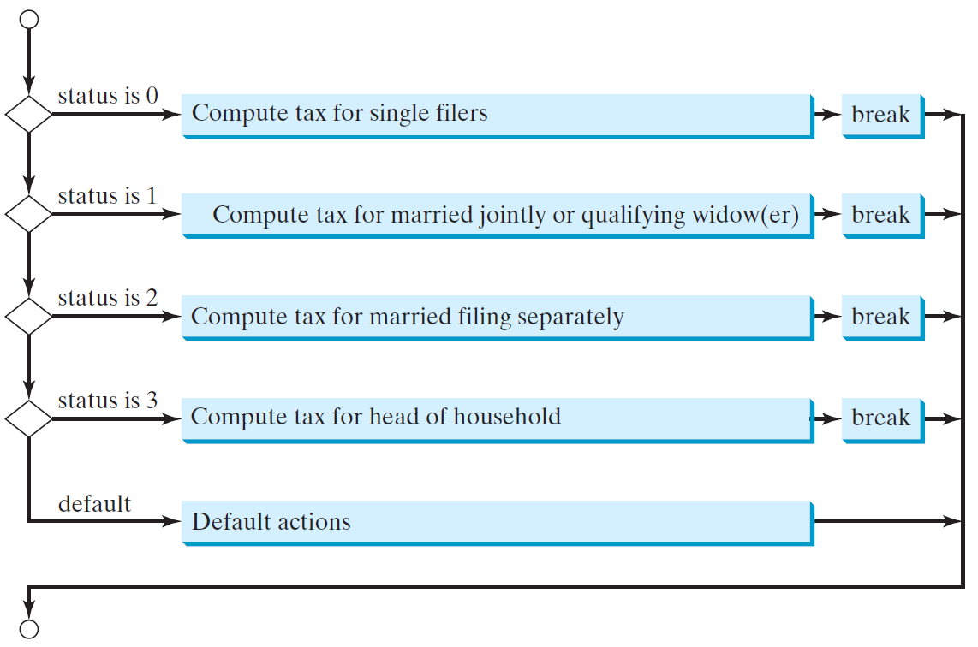
switch 语句流程图

Slide 36
switch语句的规则
switch语句中表达式的值必须是整型、字符或字符串型。即int、short、byte或者char、String型。Switch会根据表达式的值，执行符合常量表达式的语句序列
语法规则：
switch (switch-expression) {
case value1: statement(s)1;
break;
case value2: statement(s)2;
break;
… … …
case valueN: statement(s)N;
break;
default: statement(s)-for-default;
}
当表达式的值没有匹配的常量表达式时，则执行default定义的语句序列，即“语句序列n+1”。
…… //other statement(s)

Slide 37
switch语句的规则
break 是可选的，但通常将它放在每个case分支的结尾以终止后面的case分支执行。如果某个case分支没有break结尾，则该分支执行完后，程序会继续执行后面的case分支。
switch (switch-expression) {
case value1: statement(s)1;
break;
case value2: statement(s)2;
break;
… …
case valueN: statement(s)N;
break;
default: statement(s)-for-default;
}
default是可选参数，如果没有该参数，并且所有常量值与表达式的值不匹配，那么switch语句就不会进行任何操作。

Slide 38
跟踪switch语句
动画
假设整型数 day 值是 2:
switch (day) {
case 1:
case 2:
case 3:
case 4:
case 5: System.out.println("Weekday"); break;
case 0:
case 6: System.out.println("Weekend");
}

Slide 39
跟踪switch语句
动画
匹配 case 2
switch (day) {
case 1:
case 2:
case 3:
case 4:
case 5: System.out.println("Weekday"); break;
case 0:
case 6: System.out.println("Weekend");
}

Slide 40
跟踪switch语句
动画
经过 case 3
switch (day) {
case 1:
case 2:
case 3:
case 4:
case 5: System.out.println("Weekday"); break;
case 0:
case 6: System.out.println("Weekend");
}

Slide 41
跟踪switch语句
动画
经过 case 4
switch (day) {
case 1:
case 2:
case 3:
case 4:
case 5: System.out.println("Weekday"); break;
case 0:
case 6: System.out.println("Weekend");
}

Slide 42
跟踪switch语句
动画
经过 case 5
switch (day) {
case 1:
case 2:
case 3:
case 4:
case 5: System.out.println("Weekday"); break;
case 0:
case 6: System.out.println("Weekend");
}

Slide 43
跟踪switch语句
动画
遇到 break
switch (day) {
case 1:
case 2:
case 3:
case 4:
case 5: System.out.println("Weekday"); break;
case 0:
case 6: System.out.println("Weekend");
}

Slide 44
跟踪switch语句
动画
退出switch块
switch (day) {
case 1:
case 2:
case 3:
case 4:
case 5: System.out.println("Weekday"); break;
case 0:
case 6: System.out.println("Weekend");
}
思考&设计编程： WhatDayIsSomeday.java
假设今天是星期天，判断今天之后的第i天是星期几？

Slide 45
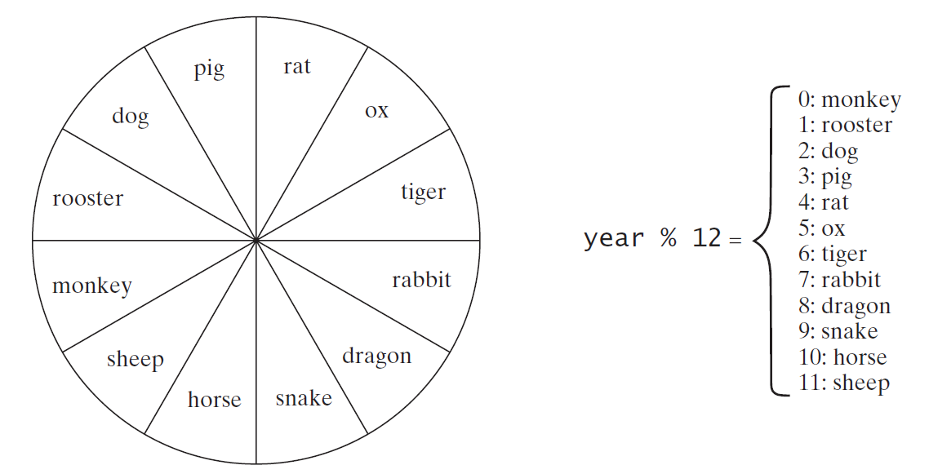
示例学习：中国生肖年份
Write a program that prompts the user to enter a year and displays the animal for the year.
ChineseZodiac

Slide 46
条件表达式
条件表达式的语法：
  boolean-expression ? exp1 : exp2
  布尔表达式 ? 表达式1:表达式2
    if (x > 0)
    y = 1;
    else
    y = -1;
等价于
    y = (x > 0) ? 1 : -1;

Slide 47
条件操作符
  符号?和:在条件表达式中同时出现。
  它们构成一种条件操作符，因为操作数有三个，所以称为三元操作符。它是java中唯一的三元操作符。
  if (num % 2 == 0)
  System.out.println(num + “ is even”);
  else
  System.out.println(num + “ is odd”);
  System.out.println(
  (num % 2 == 0)? num + “ is even” :num + “ is odd”
  );

Slide 48
条件操作符
boolean-expression ? exp1 : exp2

Slide 49
操作符优先级
最高级
var++, var--
+, - (Unary plus and minus), ++var, --var
(type) Casting
! (Not)
*, /, % (Multiplication, division, and remainder)
+, - (Binary addition and subtraction)
<, <=, >, >= (Relational operators)
==, != (Equality)
^ (Exclusive OR)
&& (Conditional AND) Short-circuit AND
|| (Conditional OR) Short-circuit OR
=, +=, -=, *=, /=, %= (Assignment operator)
最低级

Slide 50
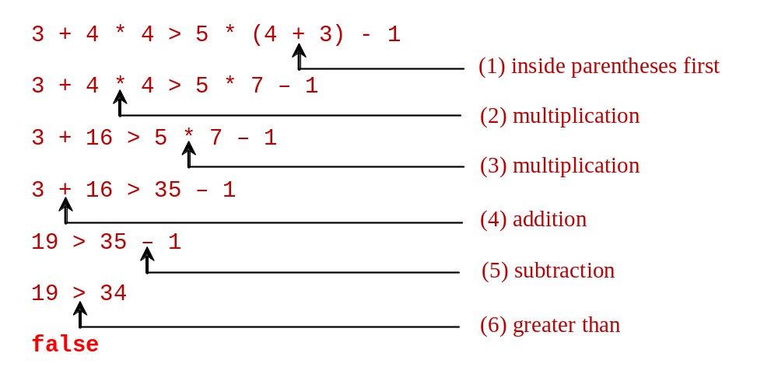
操作符优先级示例
对于表达式 3 + 4 * 4 > 5 * (4 + 3) - 1 ，利用操作符优先级的规则，计算其结果的过程如下:

Slide 51

Chapter 3

